Slide 1
Online websale
Insert the Subtitle of Your Presentation

Slide 2
TABLE OF CONTETN
I. LEARN ABOUT PHP
II. SYSTEM OVERVIEW
01
ABOUT PHP LARAVEL
01
PROBLEM DESCRIPTION
CHARACTERISTICS OF LARAVEL
02
DESIGN AND INSTALL SOLUTION
02
03
ADVANTAGES OF LARAVEL
03
TEST
04
REAL APPLICATION OF LARAVEL
III
CONCLUSION

Slide 3
LEARN ABOUT PHP LARAVEL
About Laravel
Characteristic of Laravel
Advance of Laravel
Laravel is a free and open-source PHP framework that provides a set of tools and resources to build modern PHP applications. With a complete ecosystem leveraging its built-in features, and a variety of compatible packages and extensions, Laravel has seen its popularity grow rapidly in the past few years, with many developers adopting it as their framework of choice for a streamlined development process.
Simple: Laravel functions are easy to understand and implement.
In short: most Laravel functionality works seamlessly with very minimal configuration, relying on standard rules to reduce code-bloat
Well presented: the Laravel manual is very complete and up-to-date. The developer who created the framework always updates the documentation before releasing a new version, ensuring that learners of programming always have the most up-to-date documentation.
Enhanced Performance
High Security
Powerful Authentication
Open Source & dedicated support community
Blade Templating
Migration of databases
MVC Architecture
Object-Oriented Libraries
Future-ready Apps
Unit-Testing

Slide 4

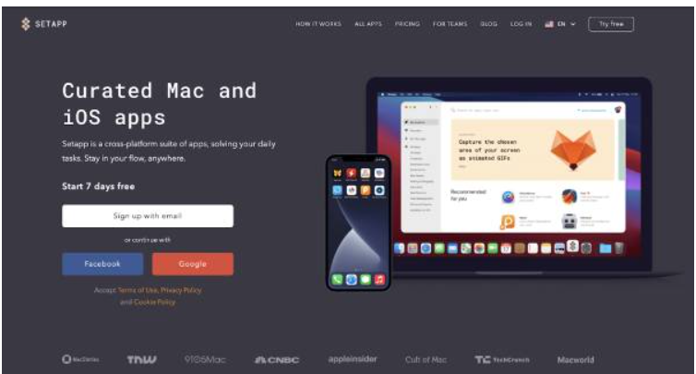
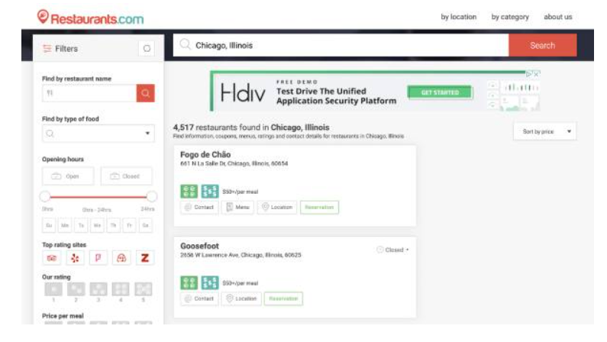
REAL APPLICATION OF LARAVEL

Slide 5
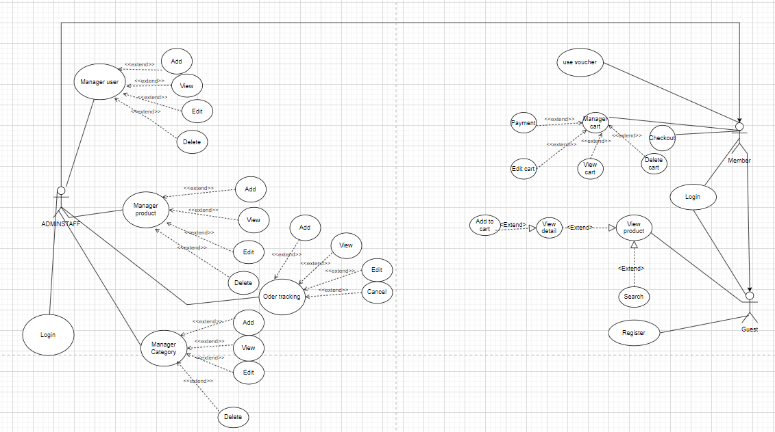
AWESOME
PRESENTATION
You can simply impress your audience and add a unique zing and appeal to your Presentations.

Slide 6
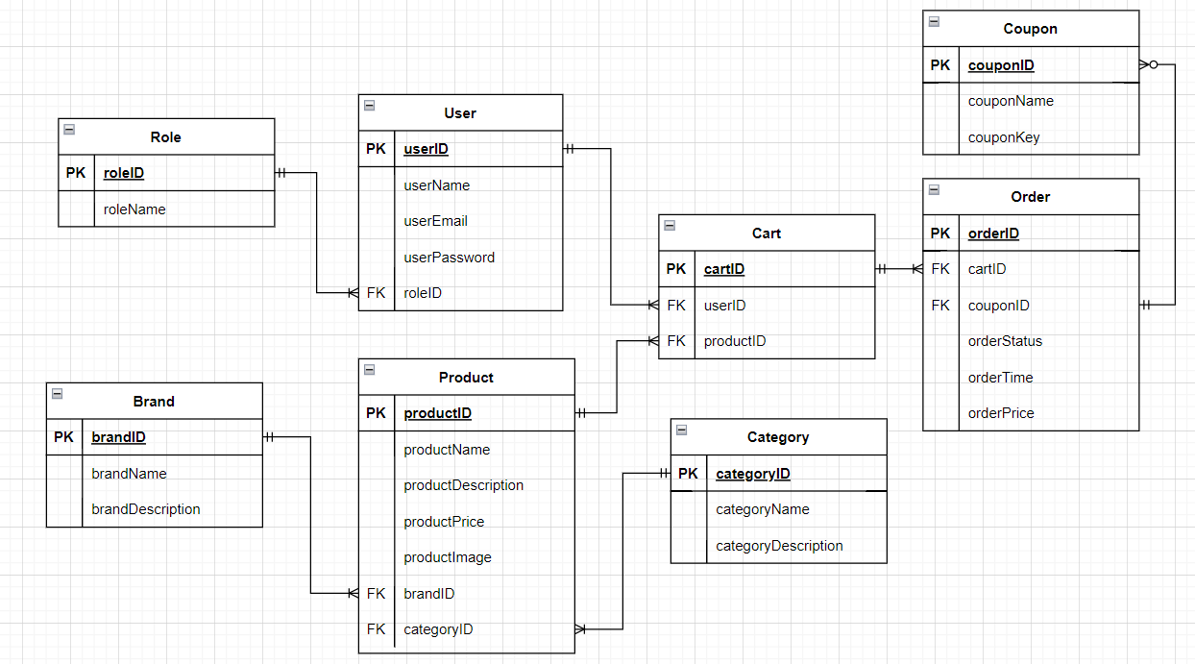
Infographic Style

Slide 7
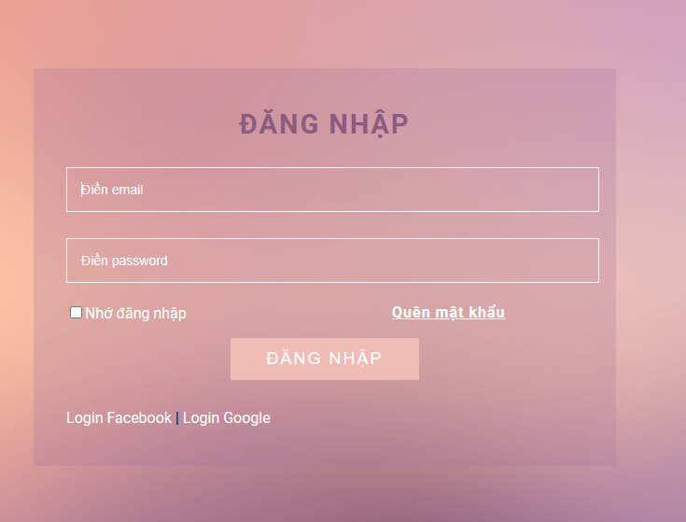

Slide 8
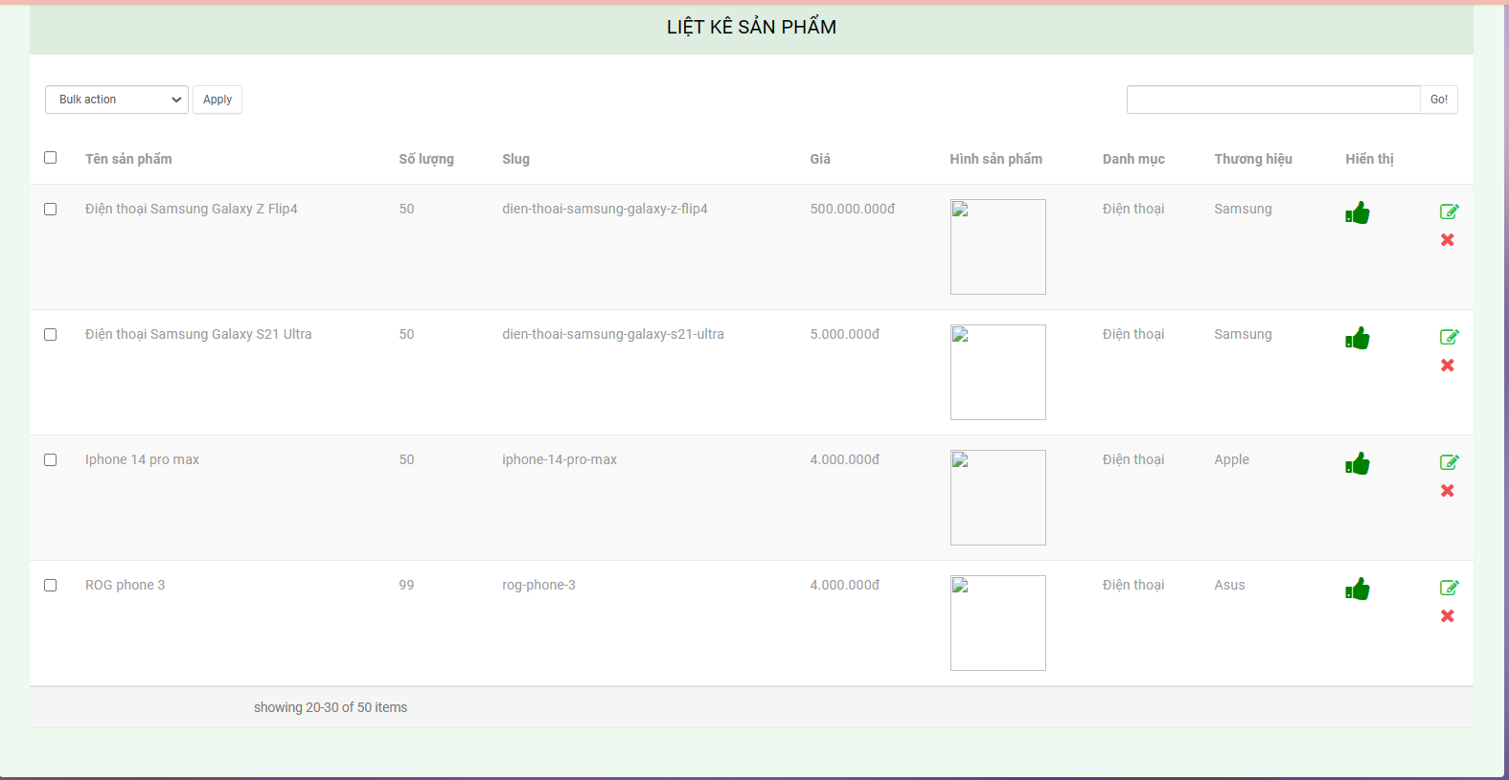

Slide 9
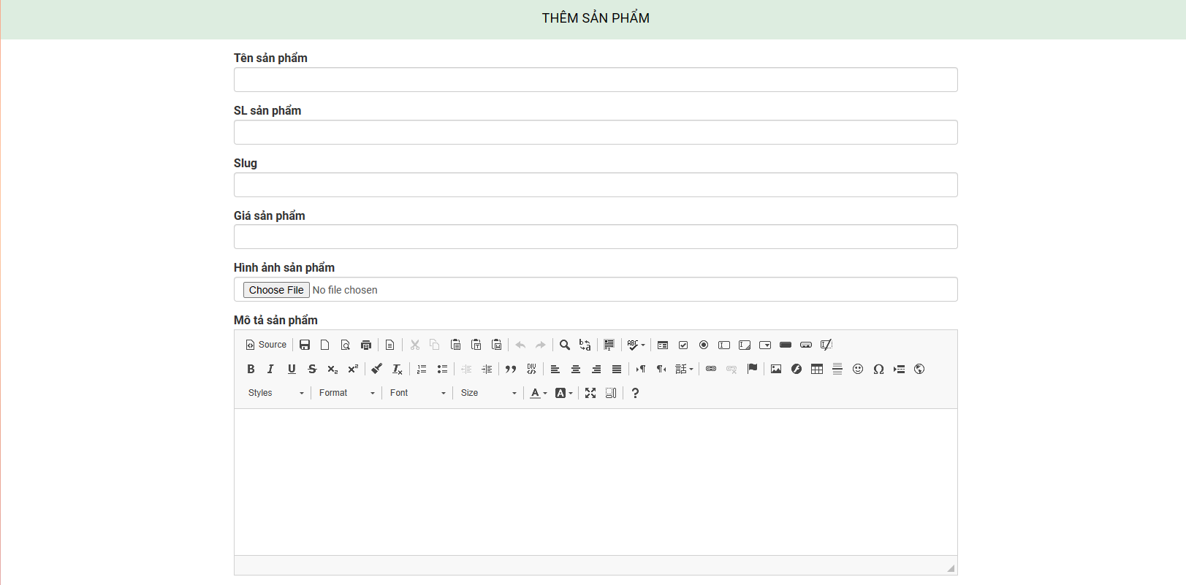
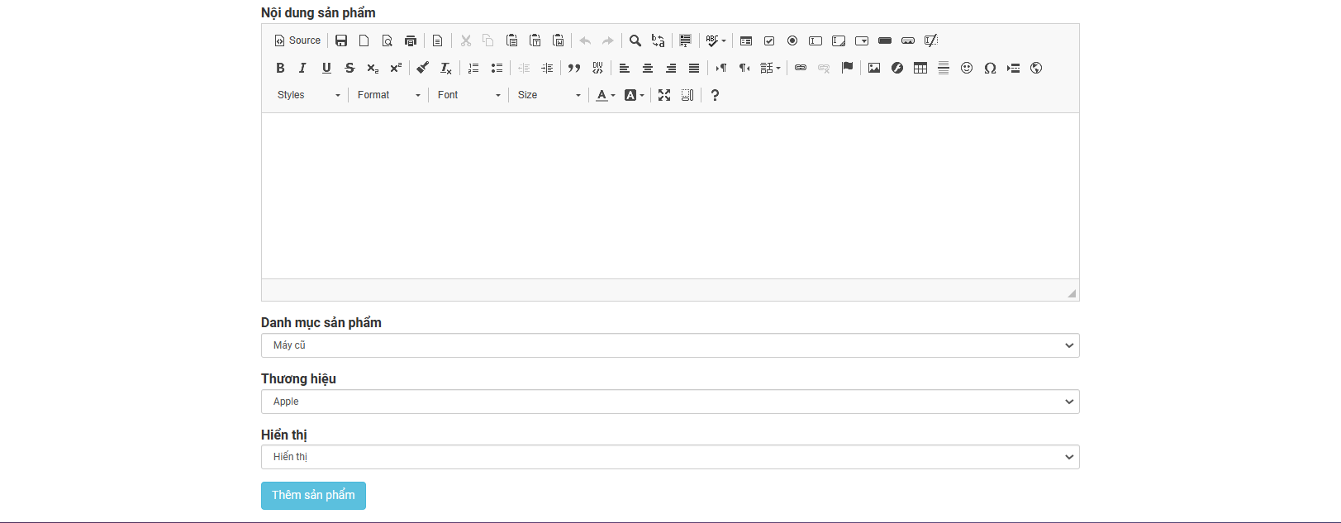

Slide 10
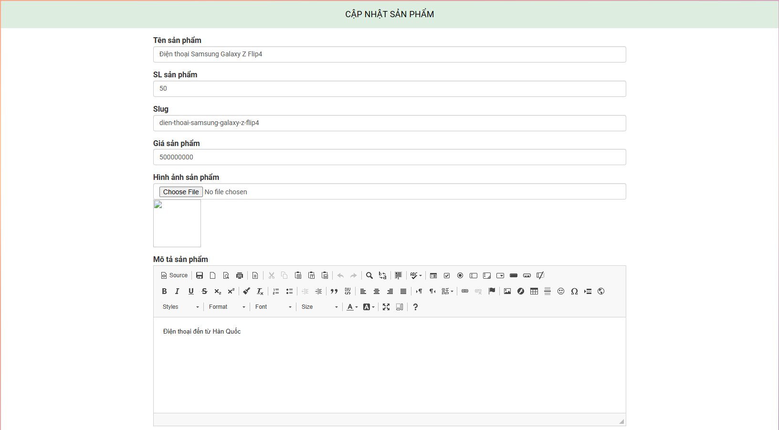
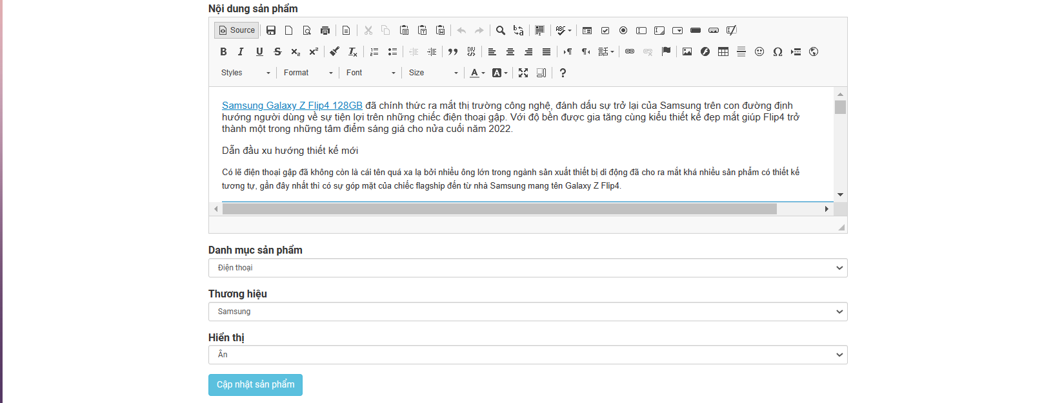

Slide 11
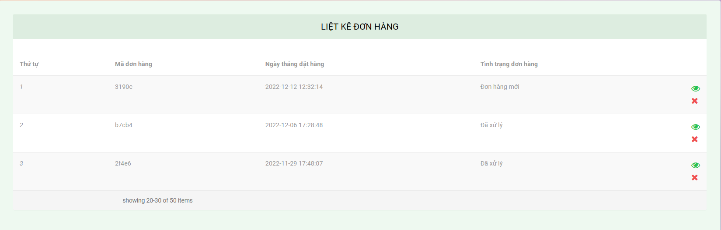

Slide 12
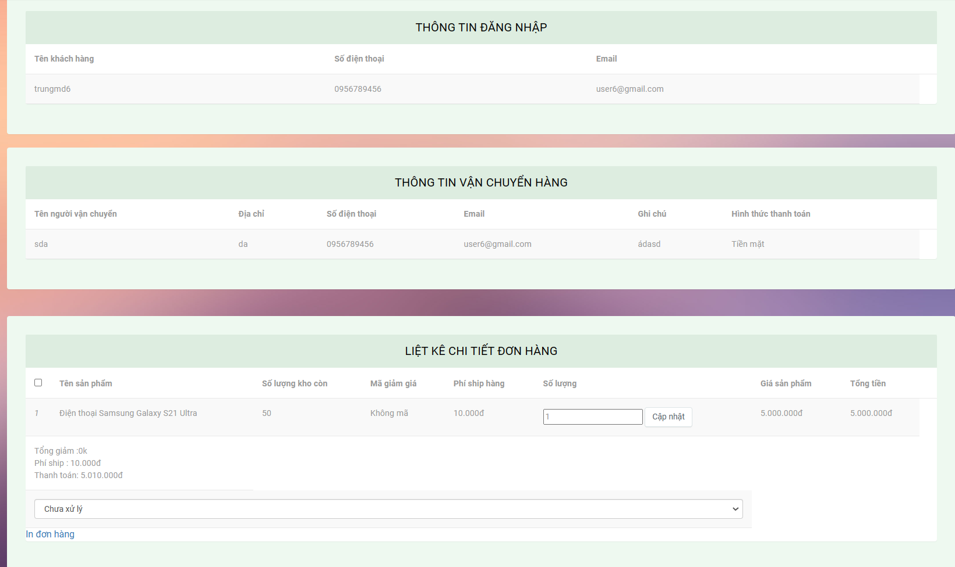

Slide 13
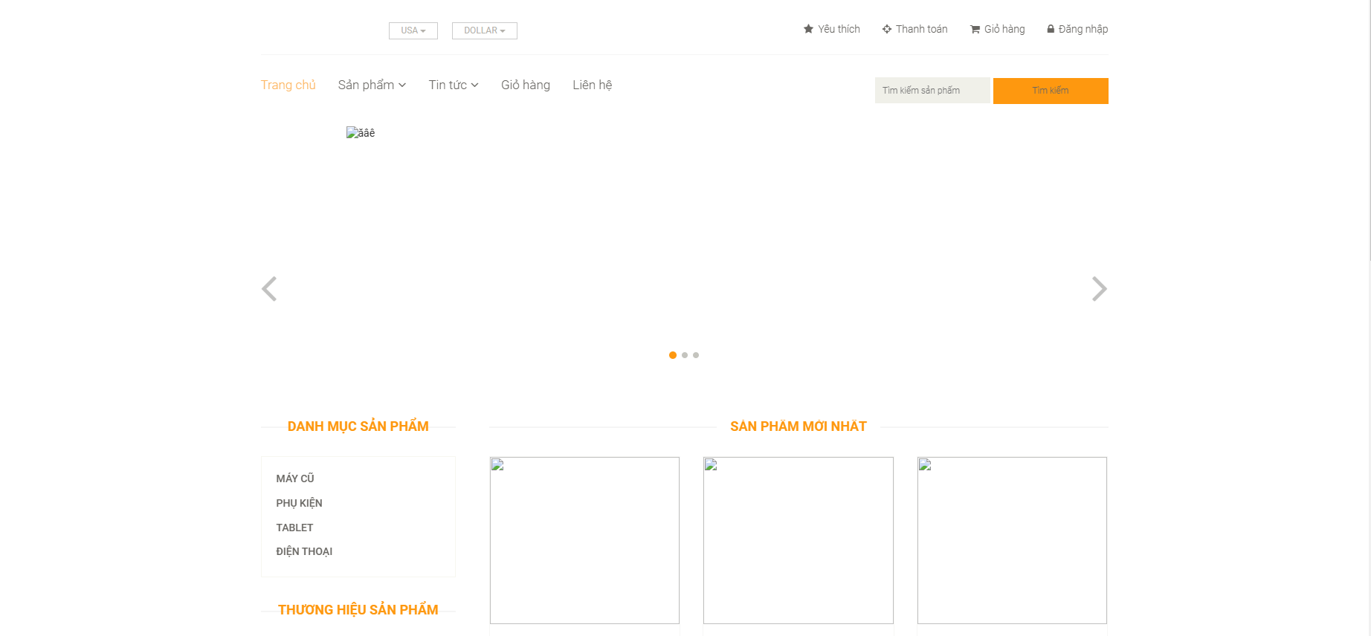

Slide 14
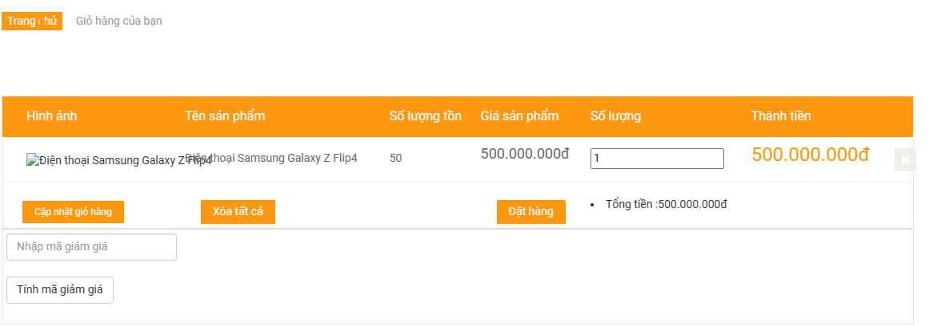

Slide 15
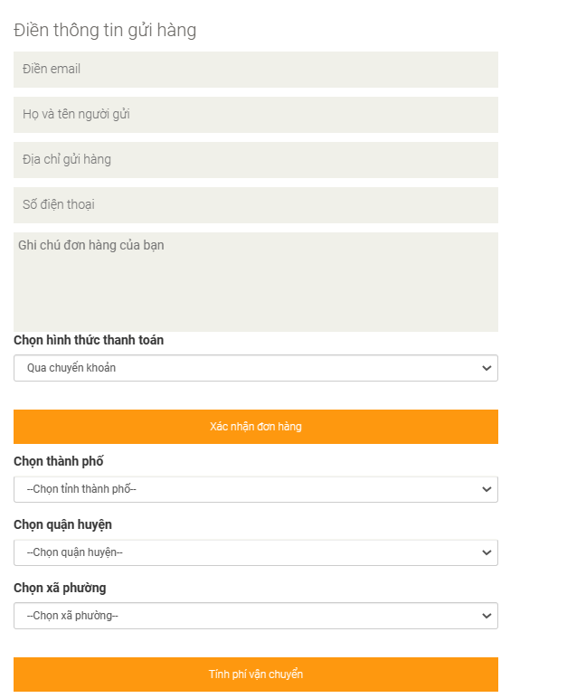
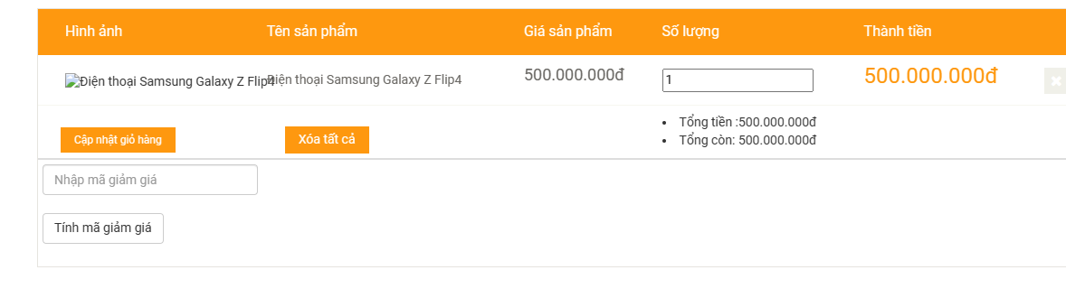

Slide 16
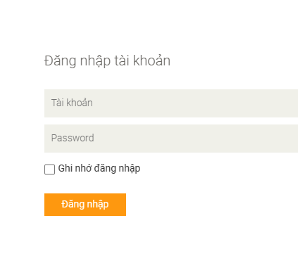
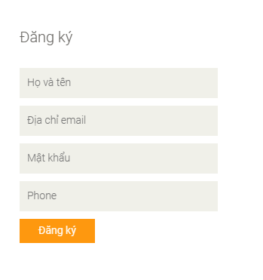

Slide 17
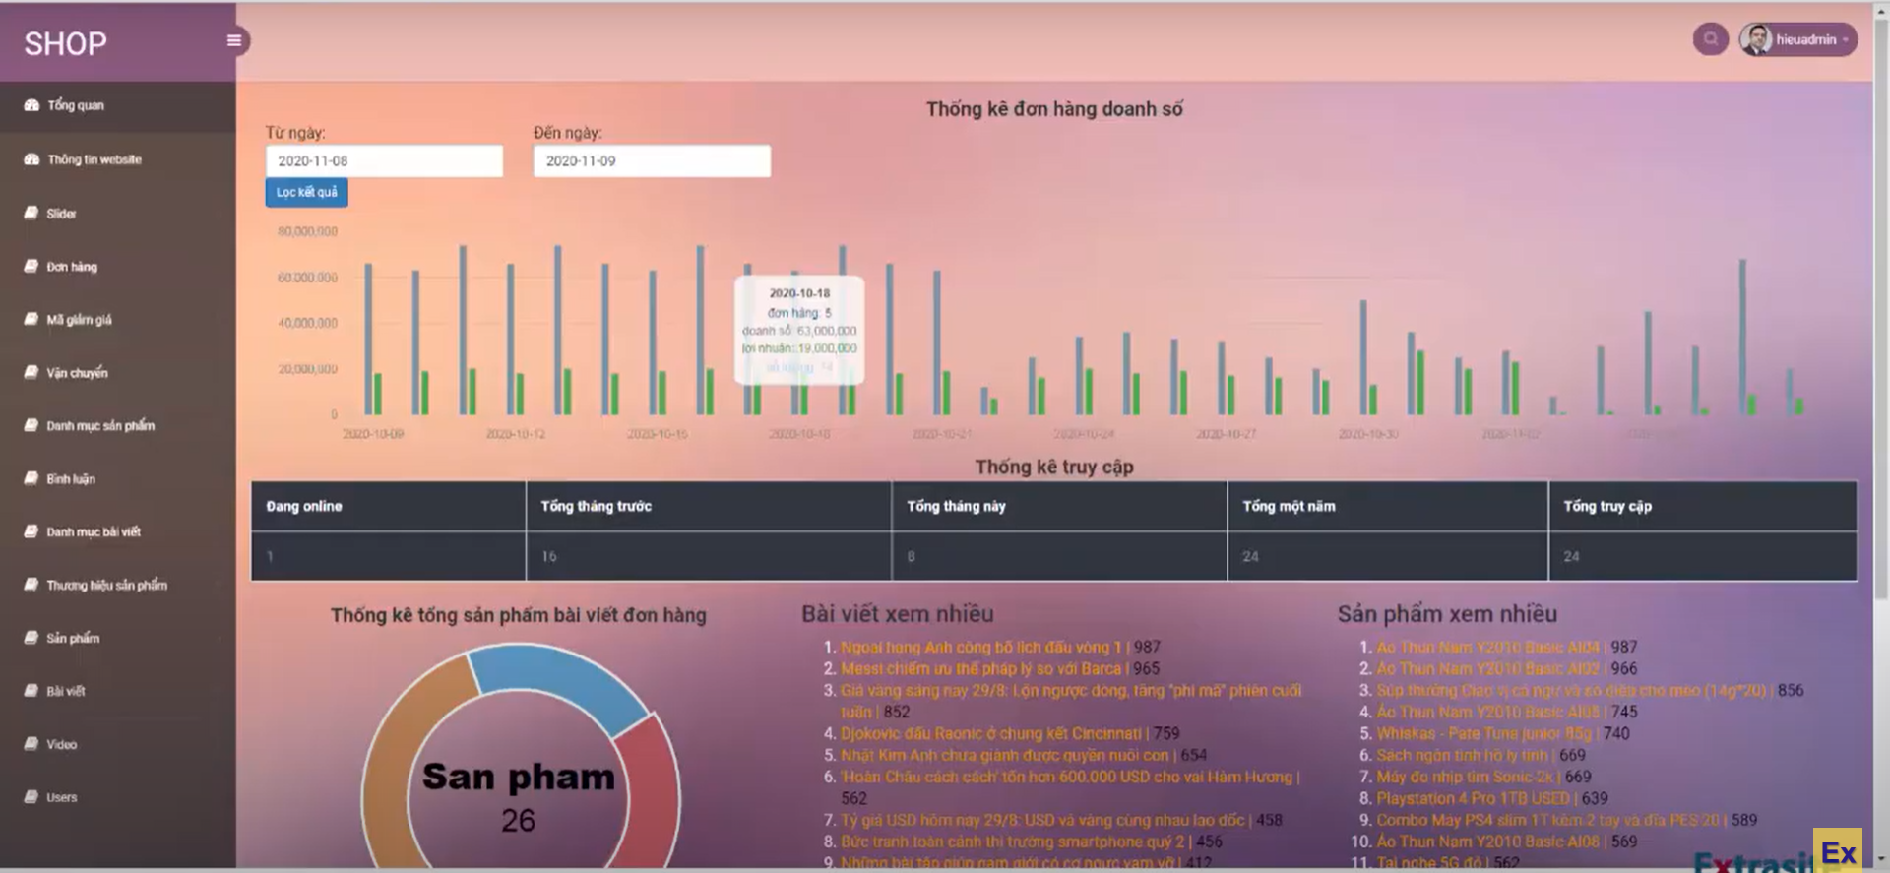

Slide 18
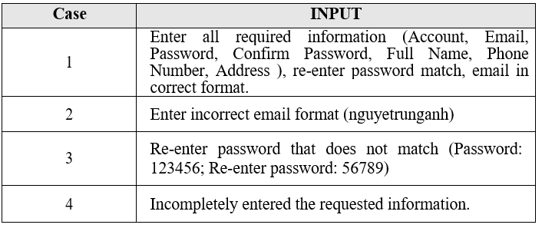
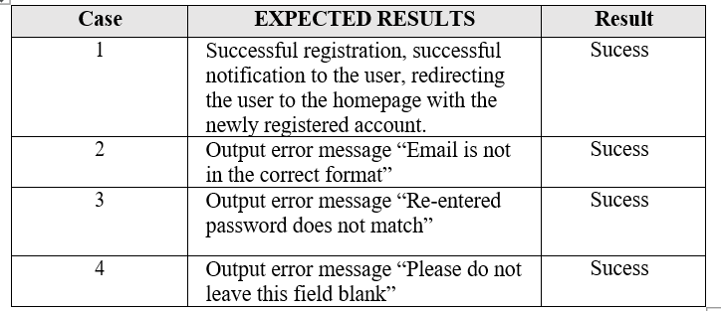

Slide 19
THANK YOU
Insert the Subtitle of Your Presentation

